Slide 1
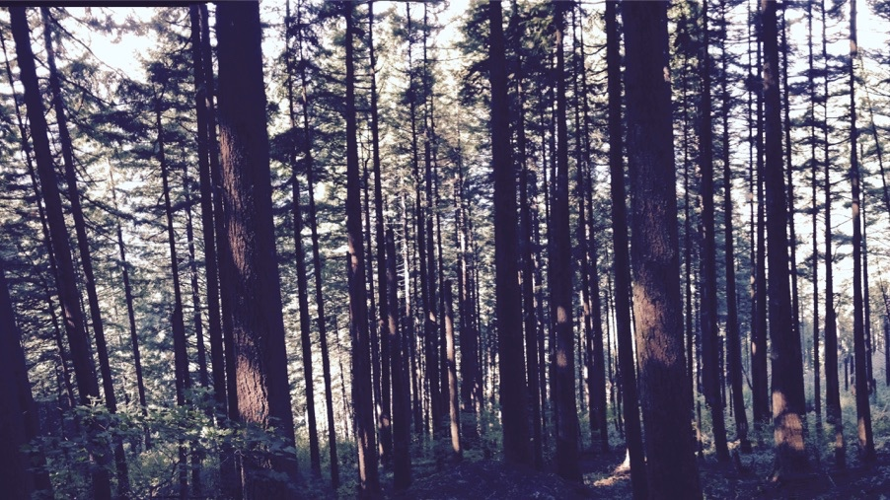
Plants aren’t dumb Using optimality theory to understand big questions in plant ecophysiology
Nick Smith
Department of Biological Sciences
Texas Tech University

Slide 2

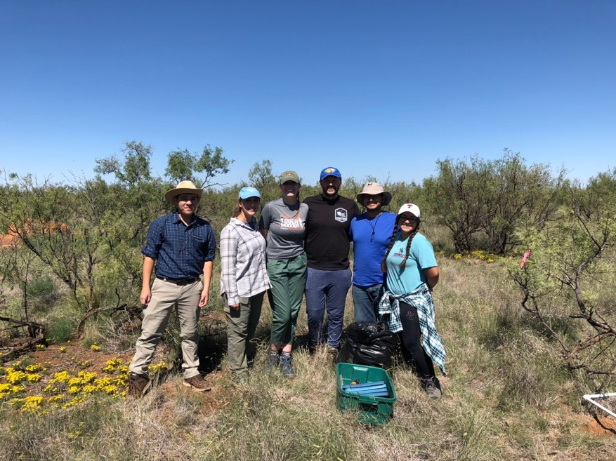
Acknowledgements
nick.smith@ttu.edu; @nick_greg_smith
Smith Ecophysiology Lab
Lizz Waring (now AProf at Northeastern State U)
Helen Scott (now in industry)
Evan Perkowski (PhD student)
Risa McNellis (MS Student)
Next Generation Ecosystem Modeling Group
Colin Prentice (Imperial College)
Trevor Keenan (UC Berkeley)
Wang Han (Tsinghua U)
Beni Stocker (ETH Zurich)

Slide 3
Photosynthesis is important!
nick.smith@ttu.edu; @nick_greg_smith

Slide 4
Photosynthesis is important!
nick.smith@ttu.edu; @nick_greg_smith
Data from IPCC (2013)

Slide 5
Photosynthesis is important!
nick.smith@ttu.edu; @nick_greg_smith
Photosynthesis
Data from IPCC (2013)

Slide 6
But predictions are uncertain!
nick.smith@ttu.edu; @nick_greg_smith
Friedlingstein et al. (2014)

Slide 7
But predictions are uncertain!
nick.smith@ttu.edu; @nick_greg_smith
Model uncertainty > fossil fuel emissions
Friedlingstein et al. (2014)

Slide 8
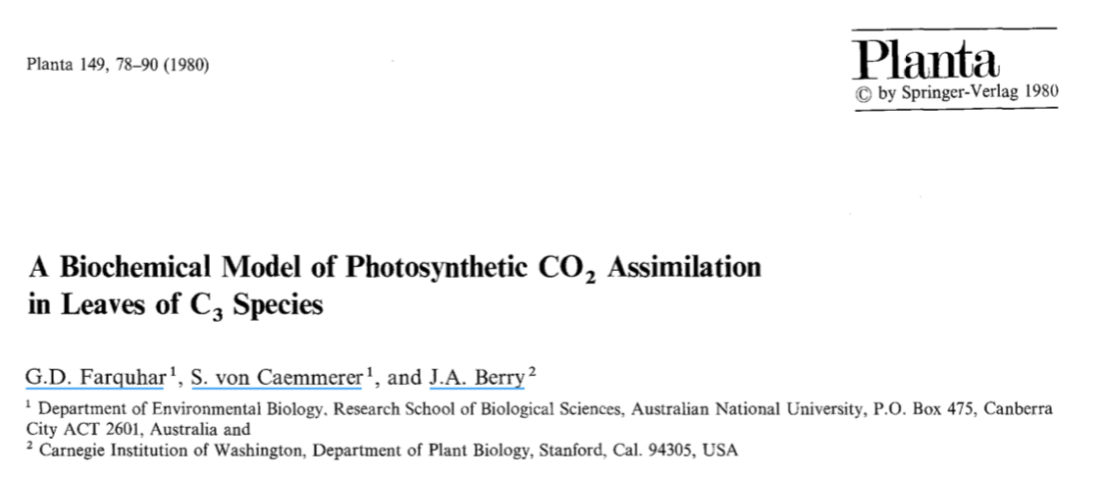
Theoretical models for photosynthesis exist
nick.smith@ttu.edu; @nick_greg_smith

Slide 9
These produce short term responses that match data
nick.smith@ttu.edu; @nick_greg_smith

Slide 10
Long-term responses can differ from short-term responses due to acclimation
nick.smith@ttu.edu; @nick_greg_smith

Slide 11
Long-term responses can differ from short-term responses due to acclimation
nick.smith@ttu.edu; @nick_greg_smith
Dumb plants

Slide 12
Long-term responses can differ from short-term responses due to acclimation
nick.smith@ttu.edu; @nick_greg_smith
Acclimated to high light
Acclimated to low light

Slide 13
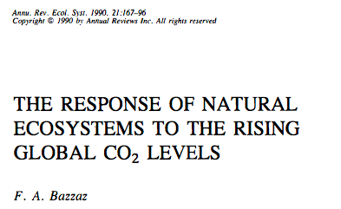
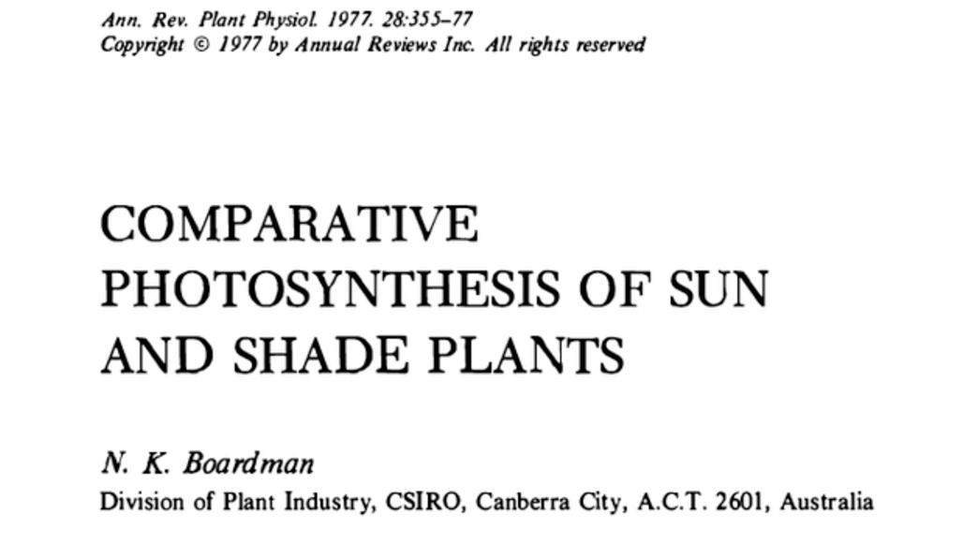
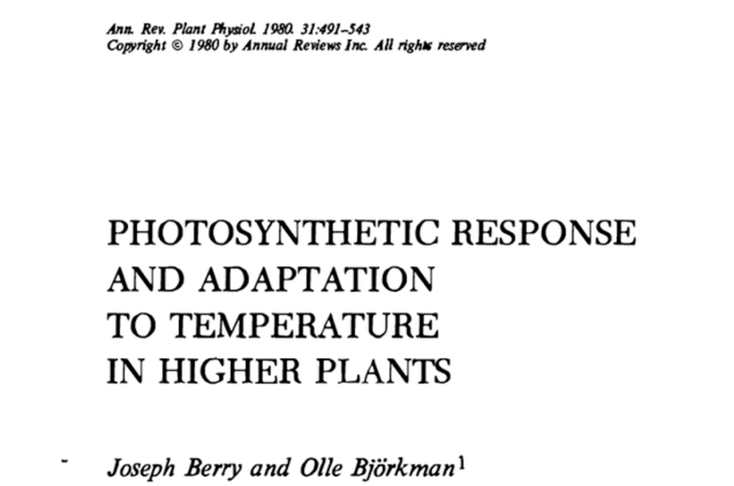
Acclimation is ubiquitous and well known…
nick.smith@ttu.edu; @nick_greg_smith
Temperature: Berry & Björkman (1980)
CO₂: Bazzaz (1990)
Light: Boardman (1977)

Slide 14
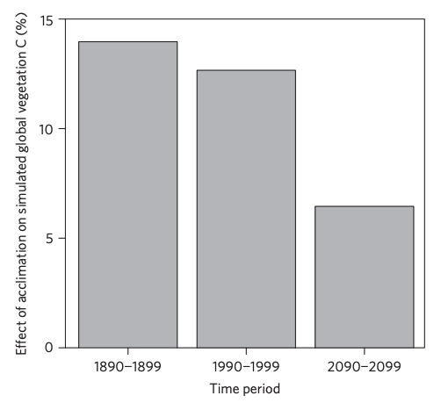
…and can possibly impact carbon cycling and climate
nick.smith@ttu.edu; @nick_greg_smith
Acclimation increase future C storage by ~6%
Acclimation alters future temperature by >1°C
Smith et al. (2017) Nature Climate Change
Smith et al. (2017) JAMES

Slide 15
Here’s the rub: No theoretical model for photosynthetic acclimation exists
nick.smith@ttu.edu; @nick_greg_smith

Slide 16
Lack of theory results in…
nick.smith@ttu.edu; @nick_greg_smith

Slide 17
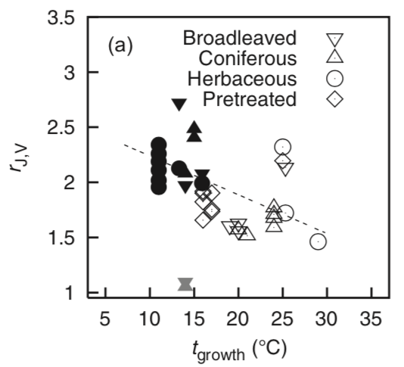
Lack of theory results in…
nick.smith@ttu.edu; @nick_greg_smith
Unreliable future predictions (overparameterization, tuning)
Reliance on statistical models
Resulting change in simulated photosynthesis
Physiological parameter
Environmental condition
Kattge and Knorr (2007) PC&E
Smith et al. (2017) JAMES

Slide 18
Lack of theory results in…
nick.smith@ttu.edu; @nick_greg_smith
Inability to test mechanisms
Resulting change in simulated photosynthesis
Physiological parameter
Environmental condition
Kattge and Knorr (2007) PC&E
Smith et al. (2017) JAMES

Slide 19
So, we developed a mechanistic model of photosynthetic acclimation Based on optimization and the first principles of plant physiological theory
nick.smith@ttu.edu; @nick_greg_smith

Slide 20
Optimization: Least cost hypothesis
nick.smith@ttu.edu; @nick_greg_smith
Maintain fastest rate of photosynthesis at the lowest cost (water and nutrient use)
Wright et al. (2003) American Naturalist

Slide 21
Optimal photosynthesis
nick.smith@ttu.edu; @nick_greg_smith
Photosynthesis = f{stomatal conductance,
photosynthetic biochemistry}

Slide 22
Optimal photosynthesis
nick.smith@ttu.edu; @nick_greg_smith
Photosynthesis = f{stomatal conductance,
photosynthetic biochemistry}
Must predict optimal rates of both

Slide 23
Optimal photosynthesis
nick.smith@ttu.edu; @nick_greg_smith
Photosynthesis = f{stomatal conductance,
photosynthetic biochemistry}

Slide 24
nick.smith@ttu.edu; @nick_greg_smith
Open stomata:
Benefits
High CO₂ influx
Costs
High water outflux
Closed stomata:
Benefits
Low water outflux
Costs
Low CO₂ influx

Slide 25
nick.smith@ttu.edu; @nick_greg_smith
Open stomata:
Benefits
High CO₂ influx
Costs
High water outflux
Closed stomata:
Benefits
Low water outflux
Costs
Low CO₂ influx
Must maintain high amount of Rubisco to do photosynthesis

Slide 26
Optimal stomatal conductance
nick.smith@ttu.edu; @nick_greg_smith
Optimal conductance maximizes photosynthesis at least water loss and nutrient use
Water loss is from transpiration
Nutrient use is nutrients used to maintain Rubisco
Rubisco proxy is V_{cmax}

Slide 27
Stomatal conductance trait The ratio of CO₂ in the leaf to CO₂ outside of the leaf (C_{i}/C_{a})

Slide 28
nick.smith@ttu.edu; @nick_greg_smith
C_{i}/C_{a} = f{temperature,
CO₂,
vapor pressure deficit}
Prentice et al. (2014); Wang et al. (2017); Smith et al. (2019)

Slide 29
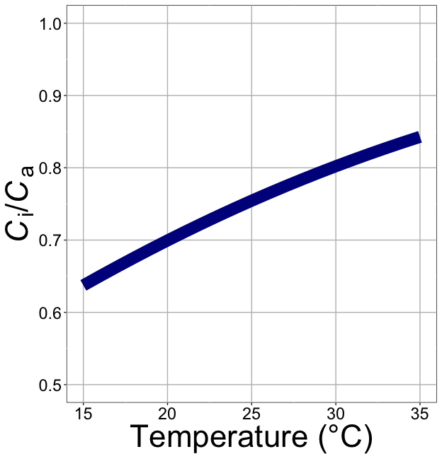
nick.smith@ttu.edu; @nick_greg_smith
C_{i}/C_{a} increases with temperature because of greater photorespiration
Smith et al. (2019)

Slide 30
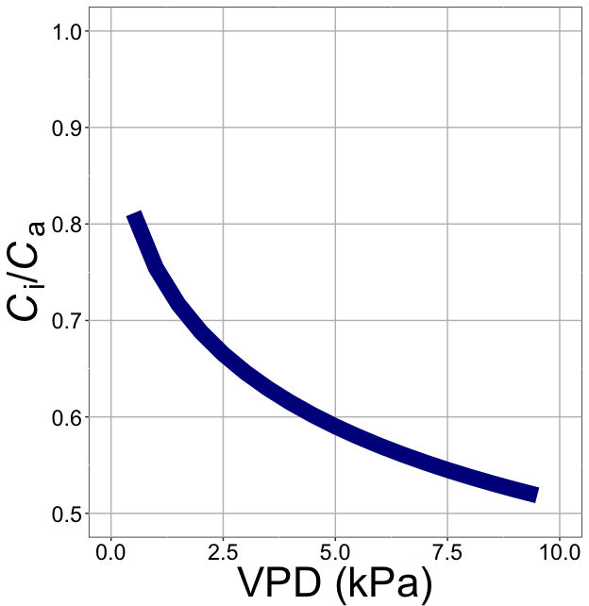
nick.smith@ttu.edu; @nick_greg_smith
C_{i}/C_{a} decreases with VPD because of greater water loss
Smith et al. (2019)

Slide 31
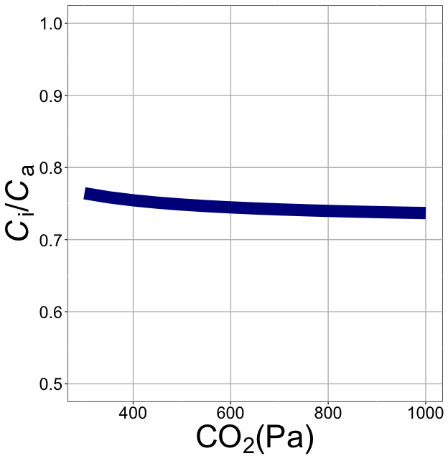
nick.smith@ttu.edu; @nick_greg_smith
C_{i}/C_{a} decreases with CO₂ because of lower openness needed to satisfy Rubisco
Smith et al. (2019)

Slide 32
Optimal photosynthesis
nick.smith@ttu.edu; @nick_greg_smith
Photosynthesis = f{stomatal conductance,
photosynthetic biochemistry}

Slide 33
Biochemistry optimization: Coordination hypothesis
nick.smith@ttu.edu; @nick_greg_smith
Plant biochemistry setup will aim for equal limitation by all factors

Slide 34
Biochemistry trait The maximum rate of Rubisco carboxylation (V_{cmax})

Slide 35
nick.smith@ttu.edu; @nick_greg_smith
V_{cmax} = f {light, T, CO₂}
Smith et al. (2019)

Slide 36
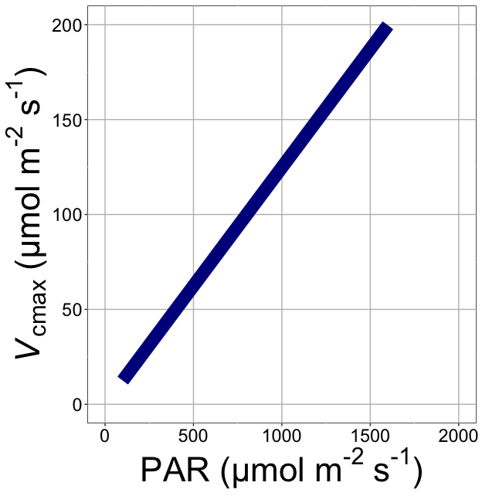
nick.smith@ttu.edu; @nick_greg_smith
V_{cmax} increases with light because of greater electron transport
Smith et al. (2019)

Slide 37
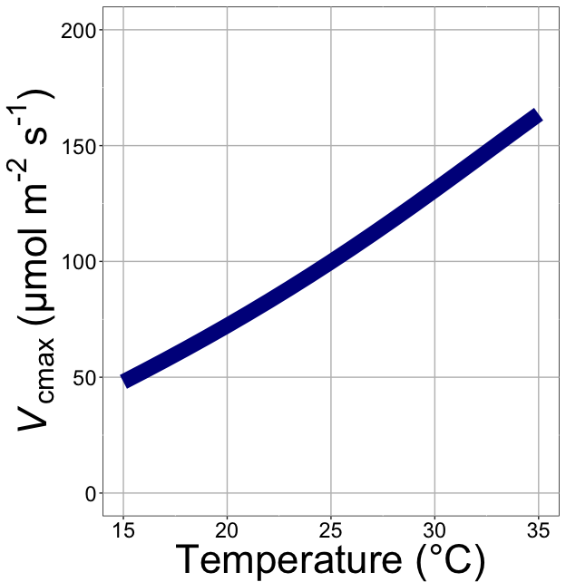
nick.smith@ttu.edu; @nick_greg_smith
V_{cmax} increases with temperature because of greater electron transport and photorespiration
Smith et al. (2019)

Slide 38
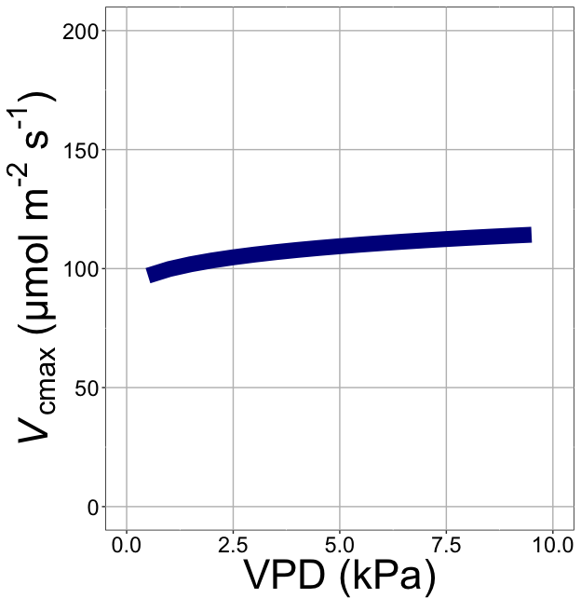
nick.smith@ttu.edu; @nick_greg_smith
V_{cmax} increases with VPD because of lower stomatal conductance
Smith et al. (2019)

Slide 39
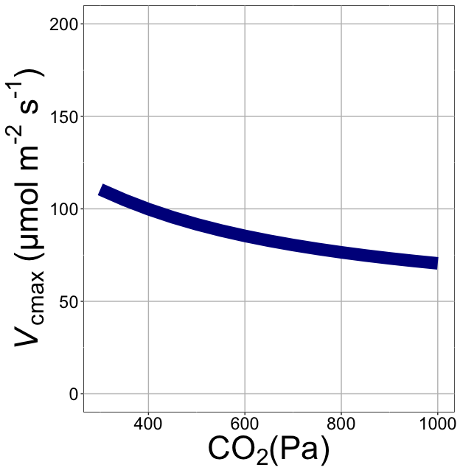
nick.smith@ttu.edu; @nick_greg_smith
V_{cmax} decreases with CO₂ because of greater CO₂ in the leaf
Smith et al. (2019)

Slide 40
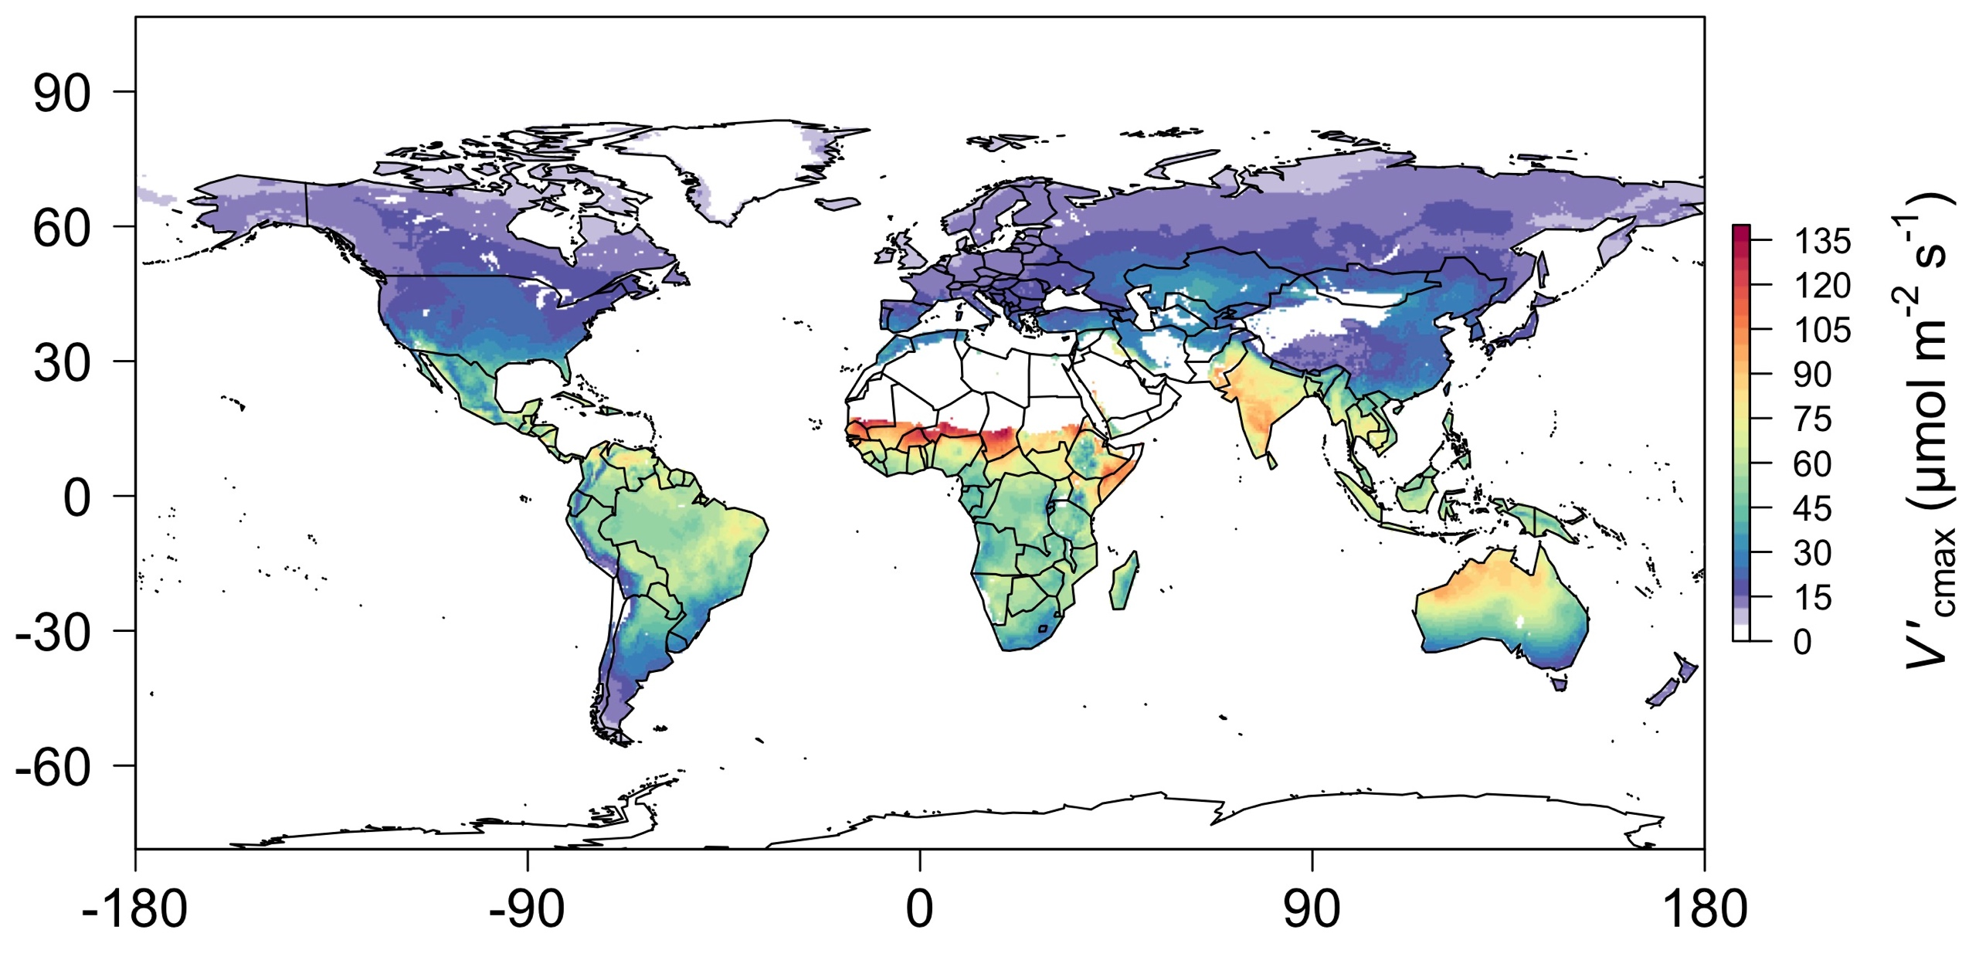
nick.smith@ttu.edu; @nick_greg_smith
Global, optimally acclimated traits!
Smith et al. (2019)

Slide 41
Ok, great, but now what?
nick.smith@ttu.edu; @nick_greg_smith

Slide 42
Let’s tackle some big questions in plant ecophysiology!
nick.smith@ttu.edu; @nick_greg_smith

Slide 43
Question 1: Is photosynthesis optimized to the environment?
nick.smith@ttu.edu; @nick_greg_smith

Slide 44
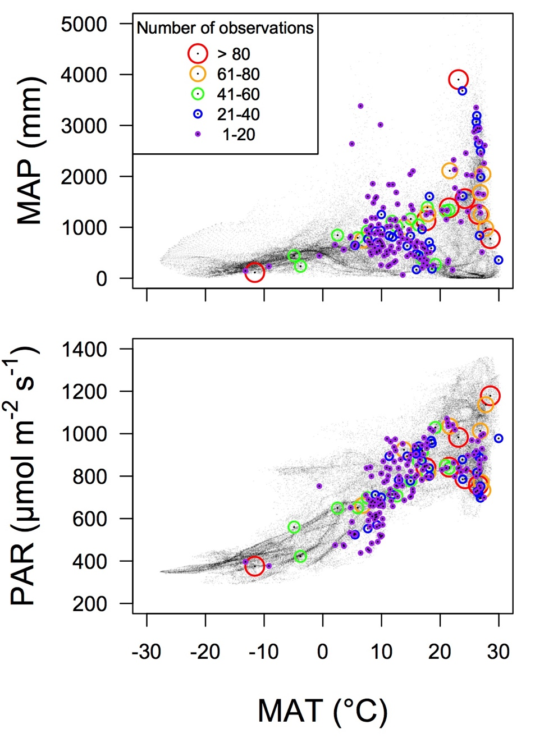
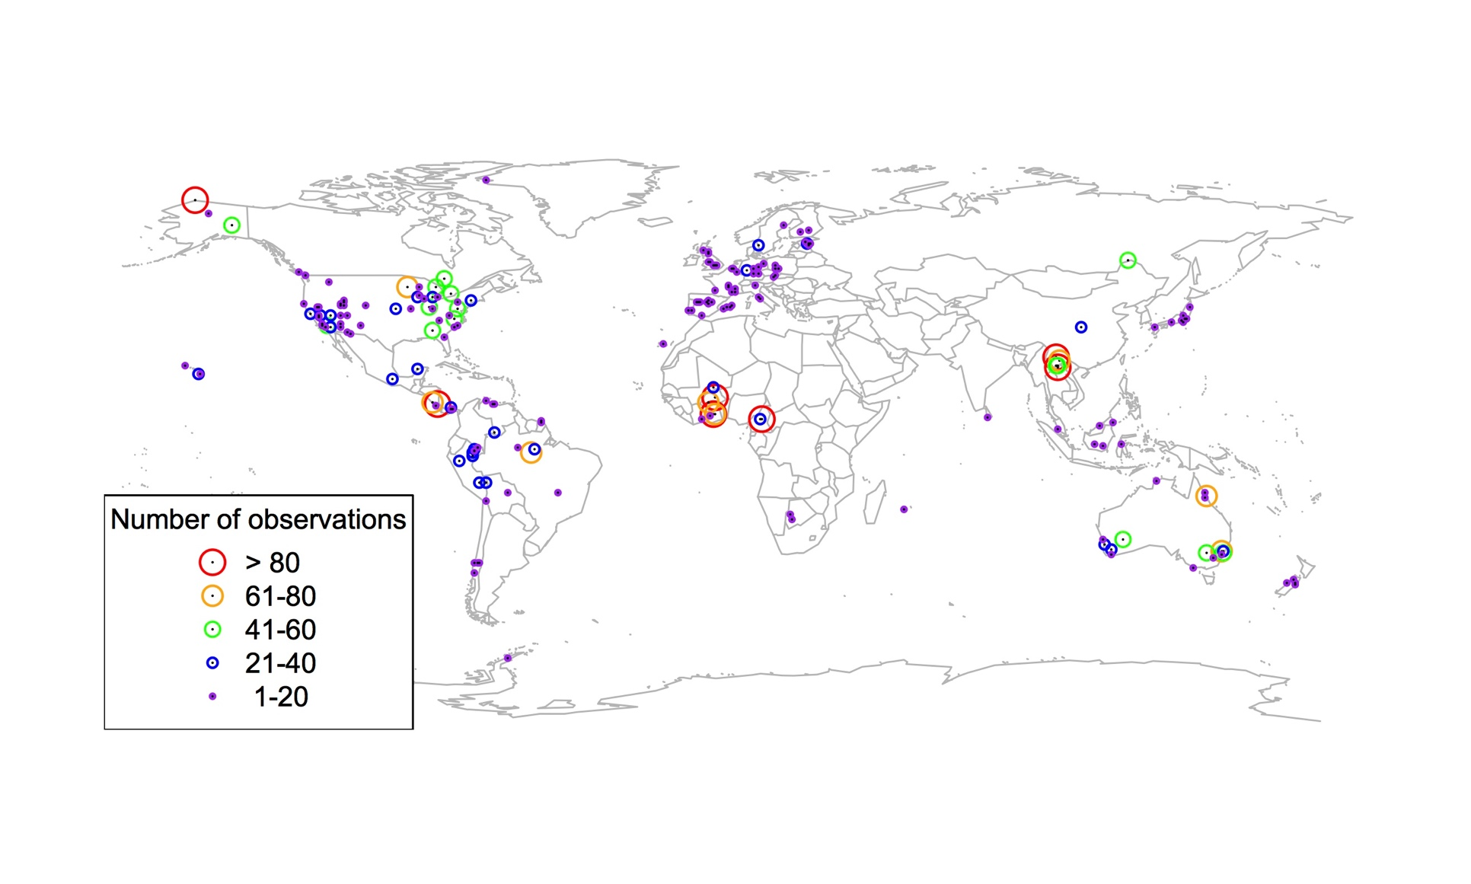
Global V_{cmax} dataset
nick.smith@ttu.edu; @nick_greg_smith
3,697 measurements
202 sites
> 600 genera
Smith et al. (2019)

Slide 45

nick.smith@ttu.edu; @nick_greg_smith
Smith et al. (2019)

Slide 46
nick.smith@ttu.edu; @nick_greg_smith
Optimal V_{cmax} is similar to observed values
Smith et al. (2019)

Slide 47
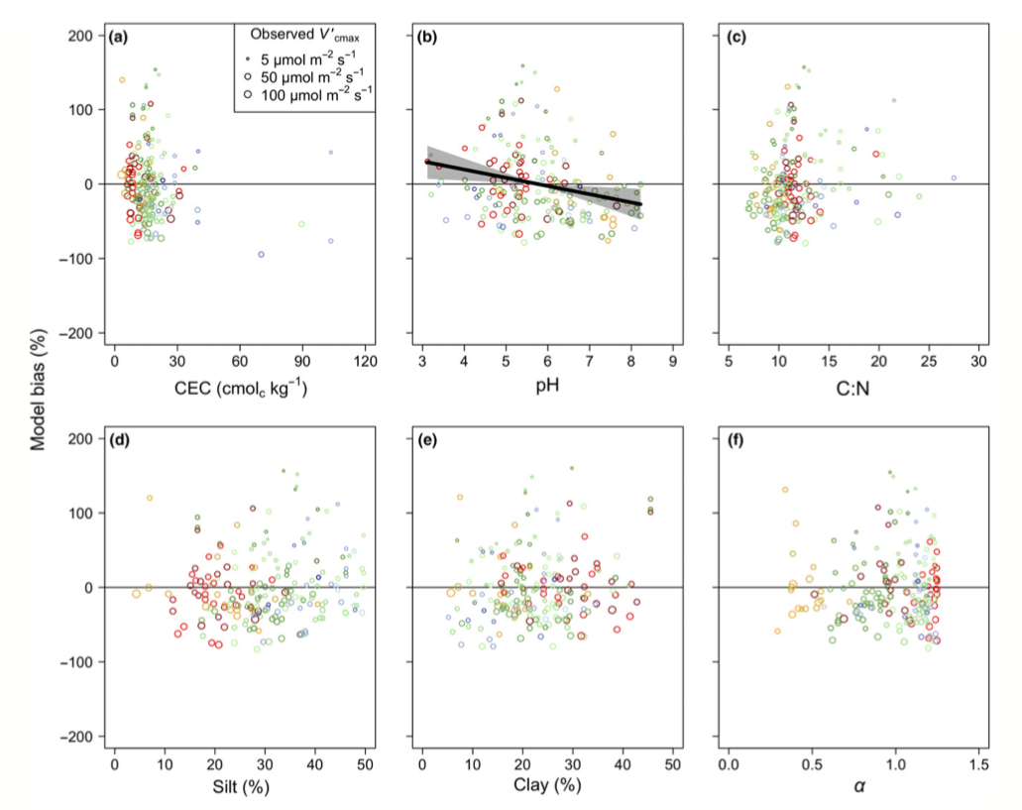
There is little effect of soils on V_{cmax}
nick.smith@ttu.edu; @nick_greg_smith
Soil increased explained variation from 64% to 68% compared to optimal response alone
Smith et al. (2019)

Slide 48
Question 1: Is photosynthesis optimized to the environment? YES! Photosynthesis acclimates spatially as expected from optimization
nick.smith@ttu.edu; @nick_greg_smith

Slide 49
Question 2: Does photosynthesis respond to soil nutrients?
nick.smith@ttu.edu; @nick_greg_smith
Lizz Waring
TTU

Slide 50
From the least cost hypothesis…
nick.smith@ttu.edu; @nick_greg_smith
Added nutrients will not increase photosynthesis because light limitation will kick in

Slide 51
From the least cost hypothesis…
nick.smith@ttu.edu; @nick_greg_smith
Added nutrients will not increase photosynthesis because light limitation will kick in
Optimal response would be to increase leaf area

Slide 52
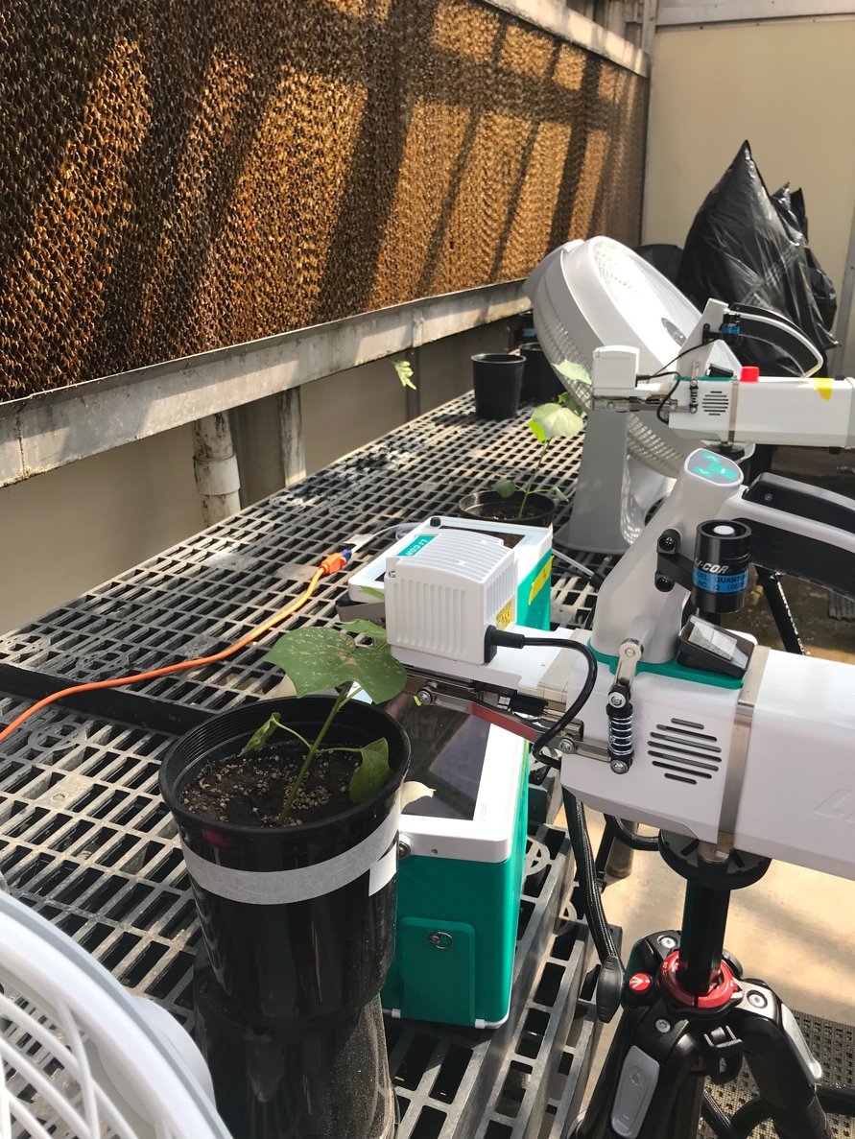
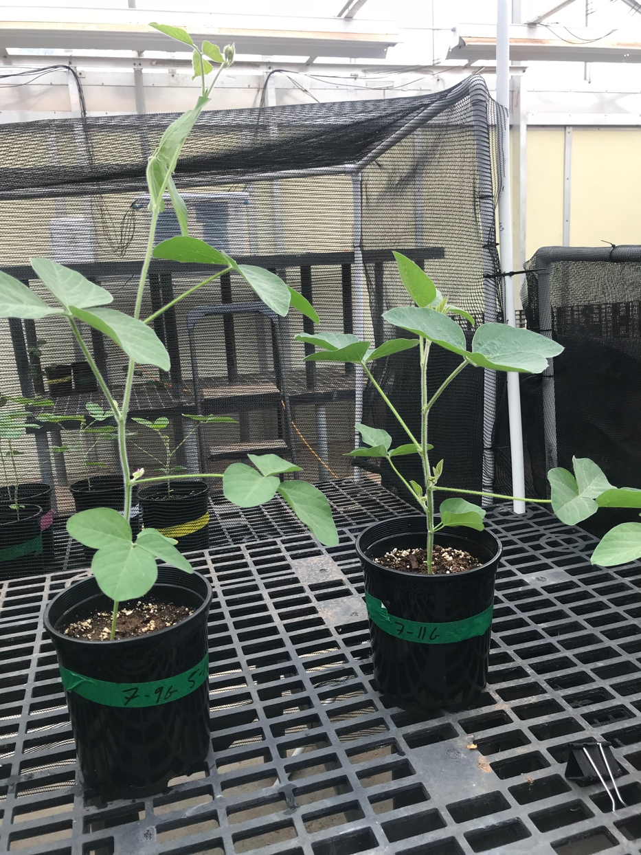
But let’s test it experimentally
nick.smith@ttu.edu; @nick_greg_smith

Slide 53
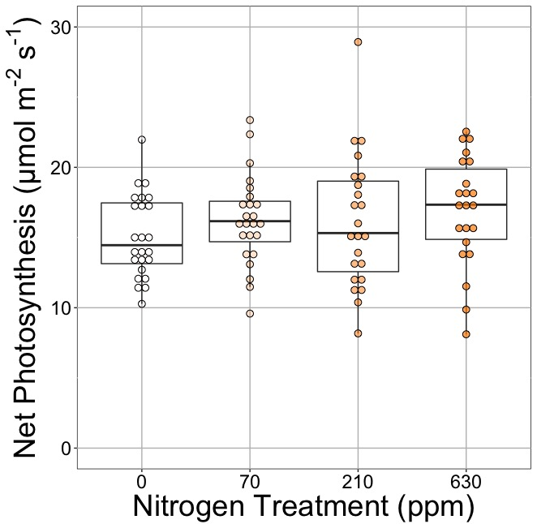
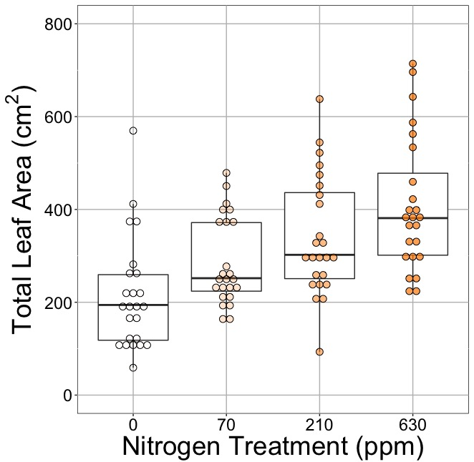
nick.smith@ttu.edu; @nick_greg_smith
Waring and Smith (in prep)

Slide 54
nick.smith@ttu.edu; @nick_greg_smith
No change (P = 0.42)
Waring and Smith (in prep)

Slide 55
Leaf area, but not photosynthesis increases with N addition
nick.smith@ttu.edu; @nick_greg_smith
No change (P = 0.42)
91% increase (P < 0.05)
Waring and Smith (in prep)

Slide 56
But do greenhouse experiments translate to the field?
nick.smith@ttu.edu; @nick_greg_smith

Slide 57
nick.smith@ttu.edu; @nick_greg_smith
Grassland soil nutrient addition network:
Leaf area index
Per-leaf-area nitrogen (photosynthetic proxy)

Slide 58
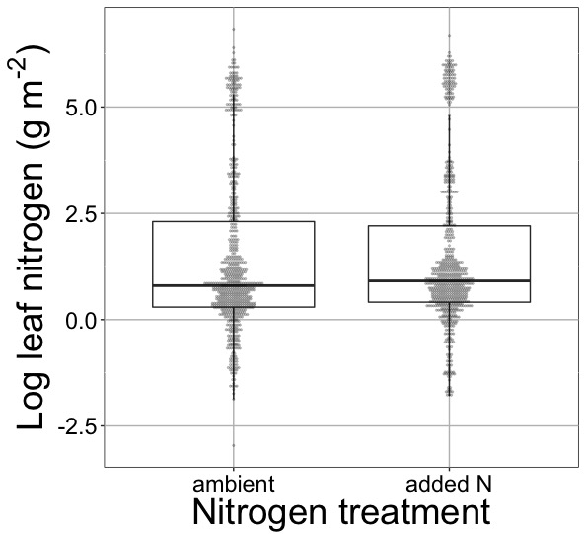
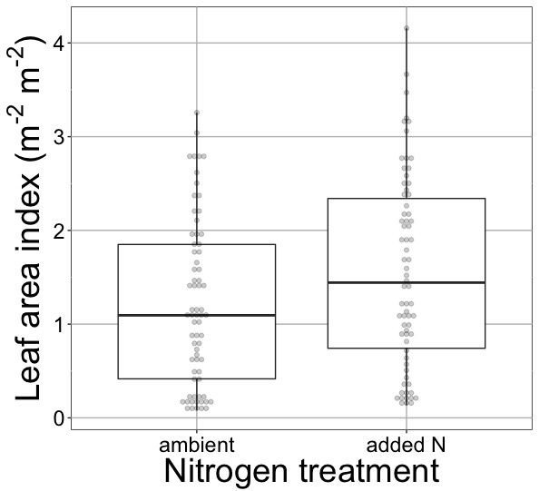
nick.smith@ttu.edu; @nick_greg_smith
Waring and Smith (in prep)

Slide 59
nick.smith@ttu.edu; @nick_greg_smith
No change (P = 0.42)
Waring and Smith (in prep)

Slide 60
Globally, N addition increases leaf area, not leaf N
nick.smith@ttu.edu; @nick_greg_smith
No change (P = 0.42)
41% increase (P < 0.05)
Waring and Smith (in prep)

Slide 61
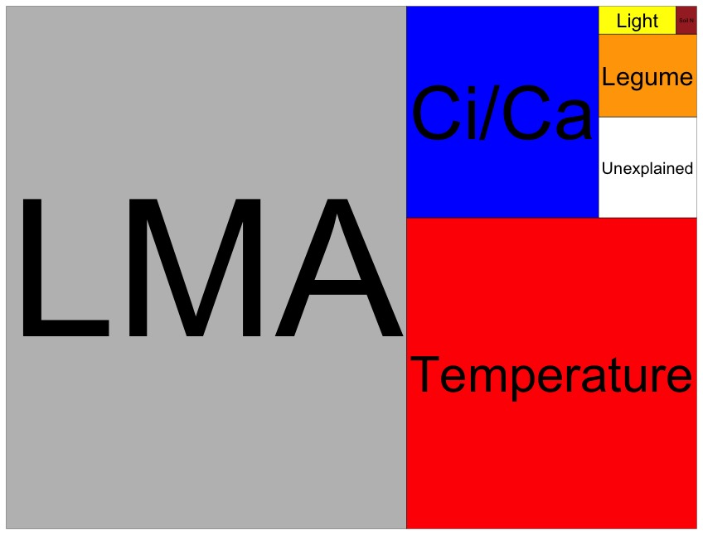
Globally, N addition has no impact on leaf N
nick.smith@ttu.edu; @nick_greg_smith
Each box is proportional to the variance in leaf N explained by each variable
Waring and Smith (in prep)

Slide 62
Question 2: Does photosynthesis respond to soil nutrients? No, plants respond to added nutrients by increasing leaf area, not photosynthesis
nick.smith@ttu.edu; @nick_greg_smith

Slide 63
Question 3: How will photosynthesis acclimate to future conditions?
nick.smith@ttu.edu; @nick_greg_smith

Slide 64
Expected future responses
nick.smith@ttu.edu; @nick_greg_smith

Slide 65
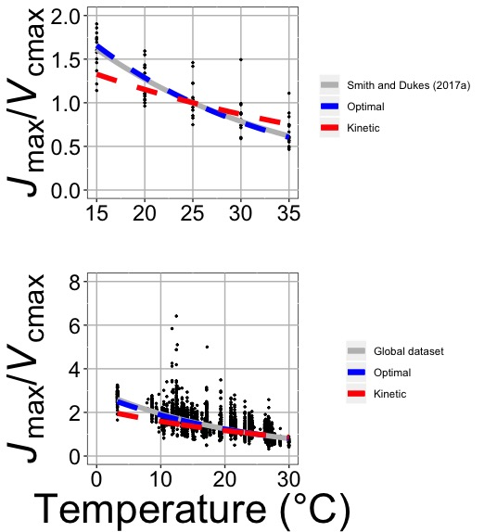
nick.smith@ttu.edu; @nick_greg_smith
Smith and Keenan (in review)

Slide 66
Photosynthetic traits change with temperature in ways expected from optimization
nick.smith@ttu.edu; @nick_greg_smith
Data = -0.051 °C⁻¹
Predicted = -0.048 °C⁻¹
Smith and Keenan (in review)

Slide 67
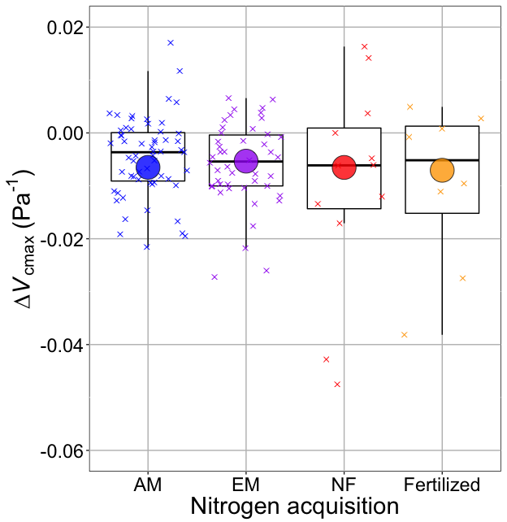
nick.smith@ttu.edu; @nick_greg_smith
Smith and Keenan (in review)

Slide 68
V_{cmax} changes with CO₂ in ways expected from optimization
nick.smith@ttu.edu; @nick_greg_smith
Boxes = data = -0.0063 Pa⁻¹
Circles = predicted = -0.0066 Pa⁻¹
Smith and Keenan (in review)

Slide 69

What does that mean for future projections?
Qing Zhu (LBNL)
Bill Riley (LBNL)

Slide 70
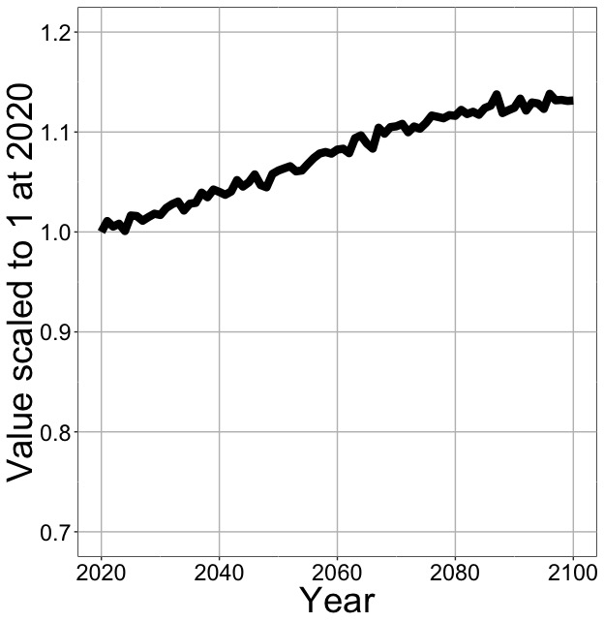
Higher CO₂ and increased temperatures increase future photosynthesis
nick.smith@ttu.edu; @nick_greg_smith
Net Photosynthesis
Smith et al. (in prep)

Slide 71
Downregulation under elevated CO₂ would reduce leaf nutrient demand!
nick.smith@ttu.edu; @nick_greg_smith
Smith et al. (2019)

Slide 72
Higher CO₂ and increased temperatures increase future photosynthesis
nick.smith@ttu.edu; @nick_greg_smith
Net Photosynthesis
Smith et al. (in prep)

Slide 73
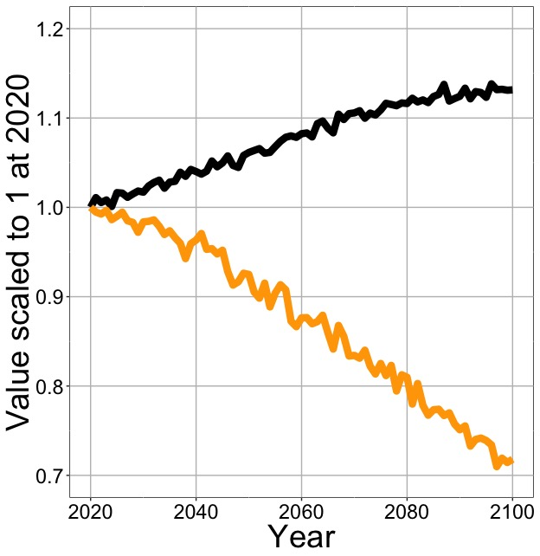
Higher CO₂ and increased temperatures increase future photosynthesis (at lower nutrient use)
nick.smith@ttu.edu; @nick_greg_smith
Net Photosynthesis
Leaf Nitrogen
Smith et al. (in prep)

Slide 74
Need to rethink nutrient limitation in models
“No limitation” simulation
“Nutrient limitation” simulations
Weider et al. (2015)

Slide 75
Question 3: How will photosynthesis acclimate to future conditions? Photosynthesis will increase and per-leaf-area nutrient use will decrease
nick.smith@ttu.edu; @nick_greg_smith

Slide 76

Question 4: When is C₄ photosynthesis an advantage over C₃ photosynthesis?
nick.smith@ttu.edu; @nick_greg_smith
Helen Scott
TTU

Slide 77
C₃ versus C₄ optimization
nick.smith@ttu.edu; @nick_greg_smith

Slide 78
C₄ versus C₃ optimization
nick.smith@ttu.edu; @nick_greg_smith
C₄ photosynthesis has…
No photorespiration
An additional limitation (PEP carboxylation)

Slide 79
C₄ versus C₃ optimization
nick.smith@ttu.edu; @nick_greg_smith
C₄ photosynthesis has…
No photorespiration
An additional limitation (PEP carboxylation)

Slide 80
nick.smith@ttu.edu; @nick_greg_smith
Relative advantage of C₄ physiology
Scott and Smith (in prep)

Slide 81
nick.smith@ttu.edu; @nick_greg_smith
Relative advantage of C₄ physiology
Scott and Smith (in prep)

Slide 82
nick.smith@ttu.edu; @nick_greg_smith
Relative advantage of C₄ physiology
Scott and Smith (in prep)

Slide 83
nick.smith@ttu.edu; @nick_greg_smith
Relative advantage of C₄ physiology
Scott and Smith (in prep)

Slide 84
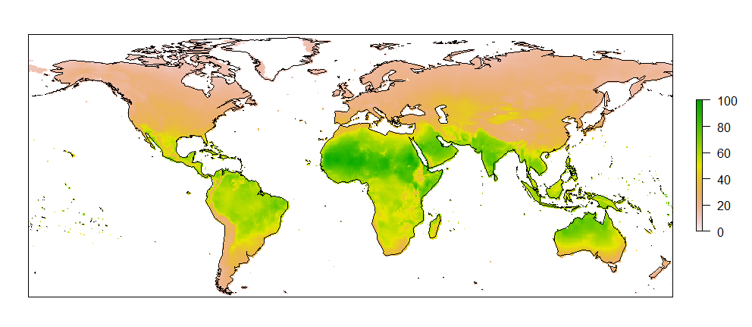
nick.smith@ttu.edu; @nick_greg_smith
Current relative advantage of C₄ (%)
Scott and Smith (in prep)

Slide 85
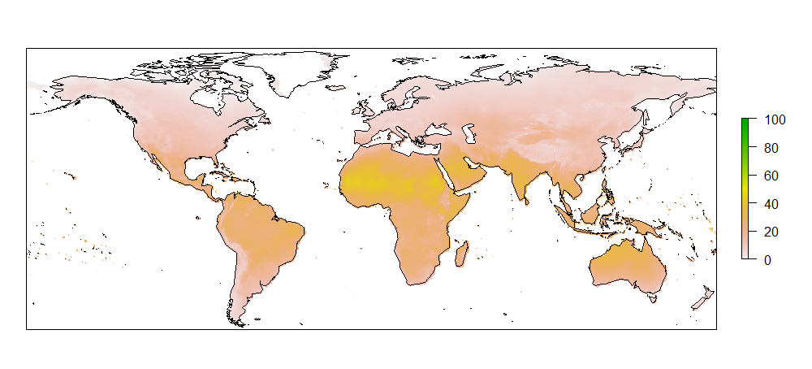
nick.smith@ttu.edu; @nick_greg_smith
Current relative advantage of C₄ (%)
Future relative advantage of C₄ (%)
Scott and Smith (in prep)

Slide 86
Question 4: When is C₄ photosynthesis an advantage over C₃ photosynthesis? C₄ is better in hot, dry, low CO₂ environments
nick.smith@ttu.edu; @nick_greg_smith

Slide 87
Conclusions
nick.smith@ttu.edu; @nick_greg_smith

Slide 88
Conclusions
nick.smith@ttu.edu; @nick_greg_smith
Plants aren’t dumb!
Need to make sure our models allow for adaptive responses
Dumb plants

Slide 89
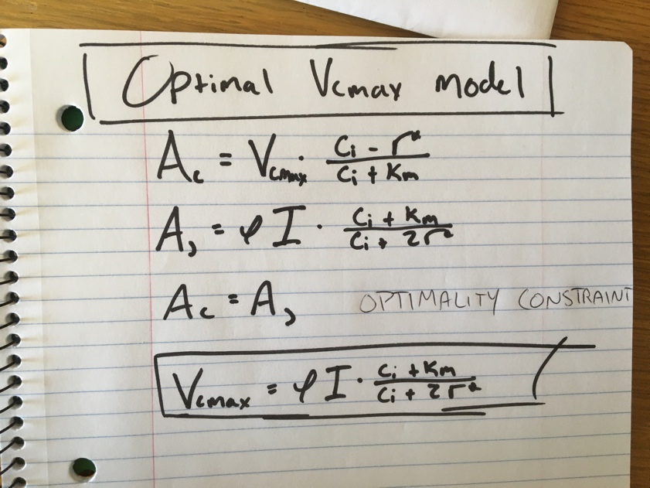
Conclusions
nick.smith@ttu.edu; @nick_greg_smith
Theory yields mechanistic insight about acclimation and associated feedbacks

Slide 90
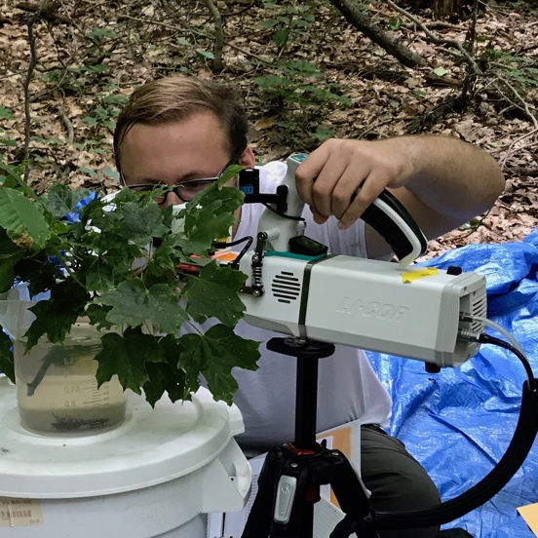
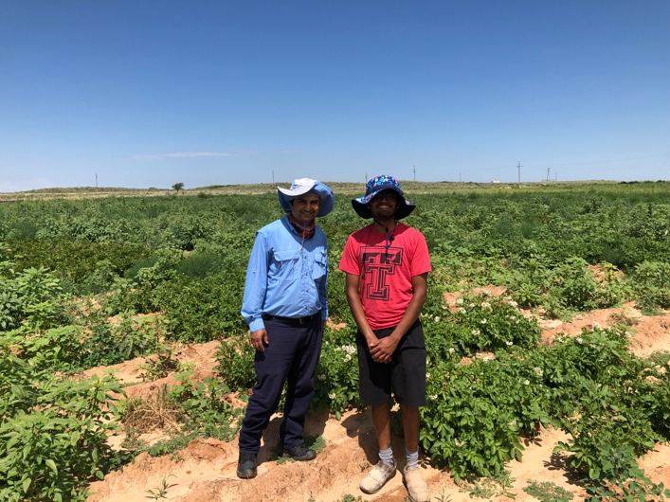
Conclusions
nick.smith@ttu.edu; @nick_greg_smith
Theory yields mechanistic insight about acclimation and associated feedbacks
We using it to study
Plant invasion
Mycorrhizal symbioses
Agriculture
Herbarium specimens

Slide 91
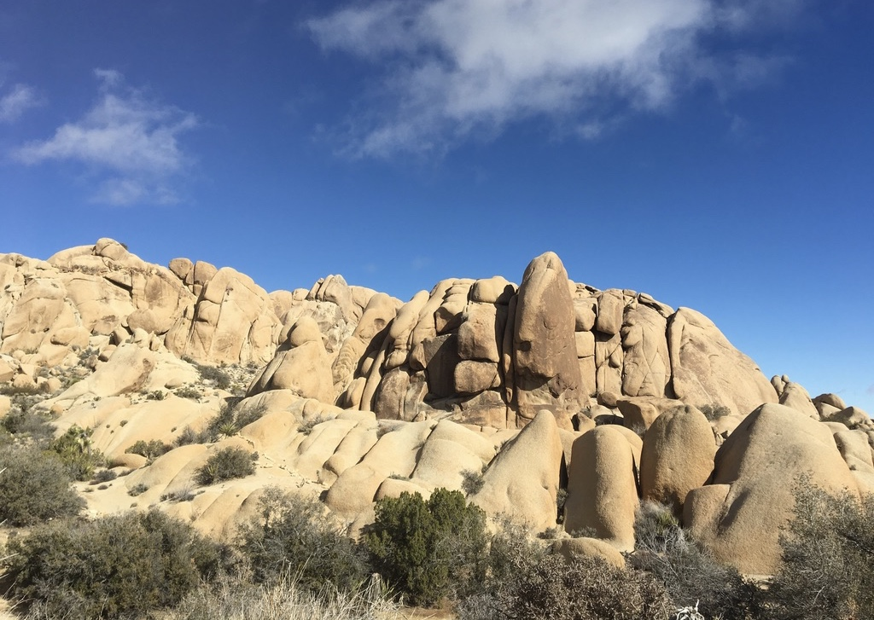
nick.smith@ttu.edu; @nick_greg_smith
Presentation available at:
github.com/SmithEcophysLab/seminar/ut_fall2019
Thanks!

Slide 92
Global leaf isotope dataset
nick.smith@ttu.edu; @nick_greg_smith
~4,000 observations
594 sites
Cornwell et al. (2018)

Slide 93
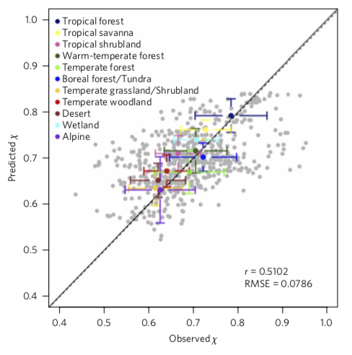
nick.smith@ttu.edu; @nick_greg_smith
Stomatal conductance is optimized!
Wang et al. (2017)

